Slide 1
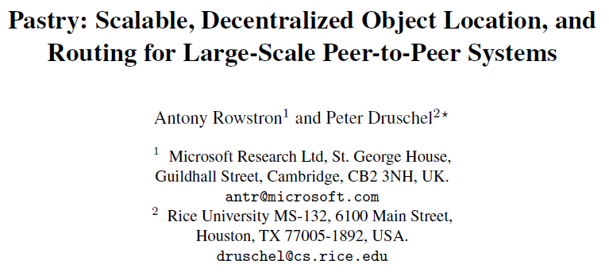
Notes:
2001

Slide 2
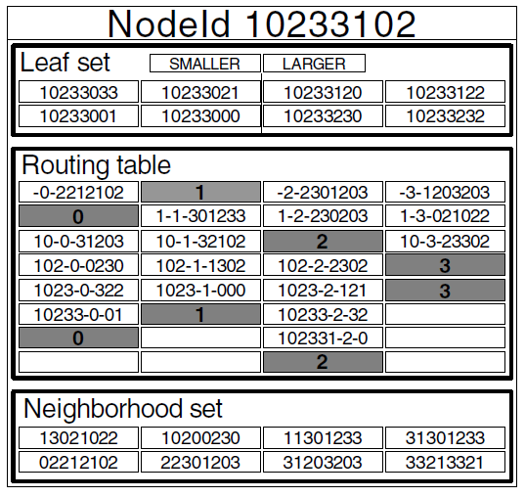
Pastry is a generic p2p content location and routing system based on a self-organizing overlay network of nodes connected via the Internet.

Slide 3
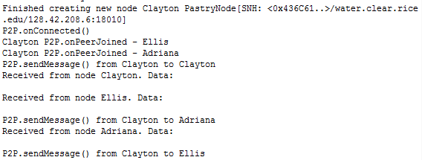
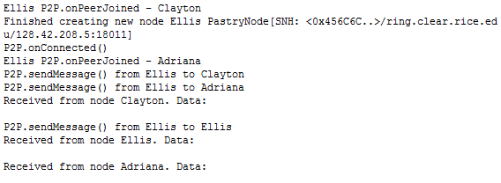
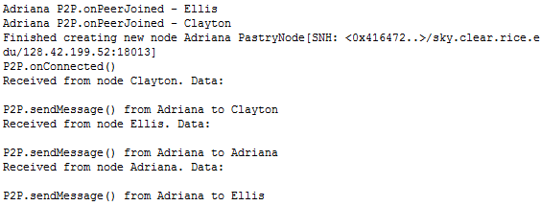
Pastry is completely decentralized, fault-resilient, scalable, and reliably routes a message to the live node with a nodeId numerically closest to a key.

Slide 4

Pastry can be used for applications like file sharing, file storage, group communication, and naming systems.

